Slide 1


WELCOME
01

Slide 2

PROJECT TITLE
STOCK MANAGEMENT SYSTEM
02

Slide 3

PROJECT MEMBERS
ABHIJIT KUMAR DAS
PRIYA RAJ
ROHIT KUMAR
SHUBHAM KUMAR VERMA
03

Slide 4
INTRODUCTION
This software is called STOCK MANAGEMENT SYSTEM Is a software for managing a shops product selling details and storage system.it has different option in order to manage a shops product details sequentially.
04

Slide 5
WHY TO IMPLEMENT
IN ORDER TO KEEP THE DATA SEQUENTIALLY TO PREVENT DATA LOSS.
TO MANUPULATE THE RECORDS PRESENT IN THE STOCK IN AN CORRECT ORDER.
TO IMPROVE THE BILLING ORDER AND TO ENHANCE IT .
TO KEEP THE TRACK RECORDS OF THE ACTIVITIES PREFORMED WITH THE STOCK.
05

Slide 6

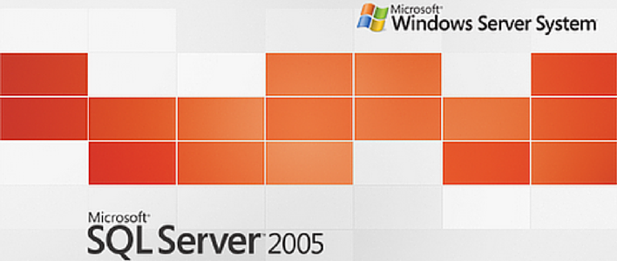
SOFTWARE REQUIREMENT
VB.NET 2008
SQL SERVER 2005
FRONT END
VB.NET 2008
BACK END
SQL SERVER 2005
06

Slide 7
HARDWARE REQUIREMENT
PROCESSOR (Pentium and above)
RAM (1GB and above)
KEYBOARD
MOUSE
07

Slide 8
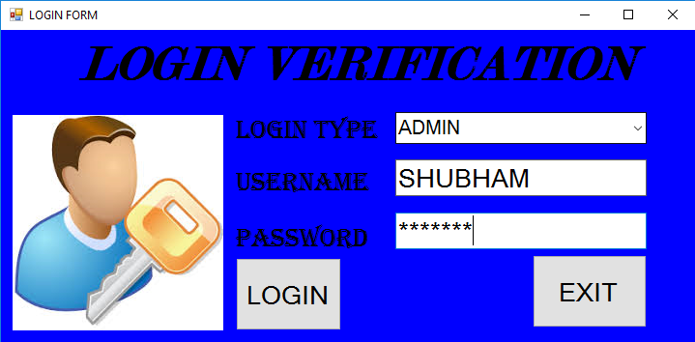
THE LOGIN FORM
08

Slide 9
The login form shown on the previous slide is used for administrator to log in. Here with proper username and password can log into the main form.
New user and the existing user can also log in.
09

Slide 10
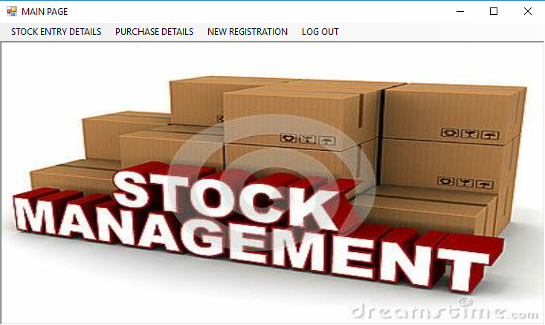
THE MAIN FORM
10

Slide 11
This is the main form where admin and user both can enter . There is administrator permission privilege in some pages on the main form.
This page is used to access on to the other stock entry and the billing pages. This page is important because this page links up with the other forms.
11

Slide 12
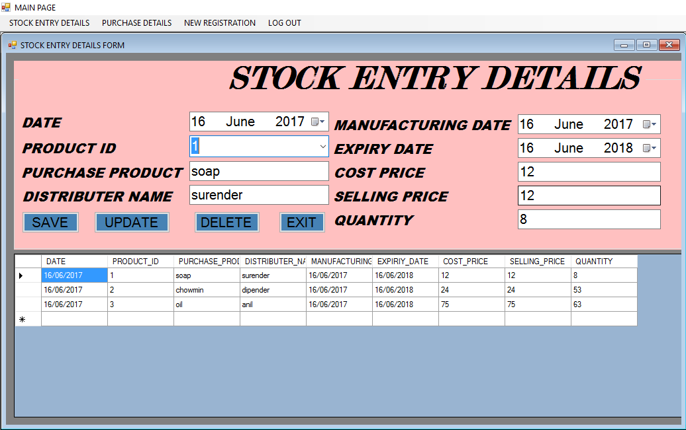
STOCK ENTRY FORM
12

Slide 13
This is the stock entry details form which is accessed by only admin.
This page keeps the record of items present in the stock individually in an optimized manner. The details can be updated and even deleted which can only be done by the permission of admin.
13

Slide 14
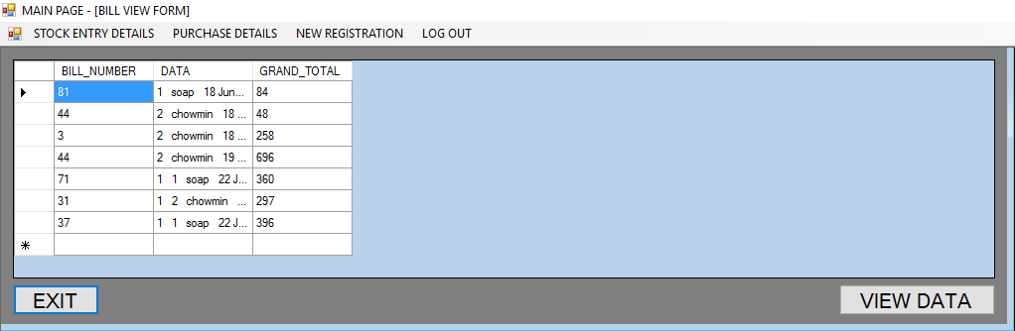
BILL VIEW FORM
14

Slide 15
This is the bill view form which can only be accessed by admin.
This page shows the number of bills printed . It also have the facility to print preview the data page.
15

Slide 16
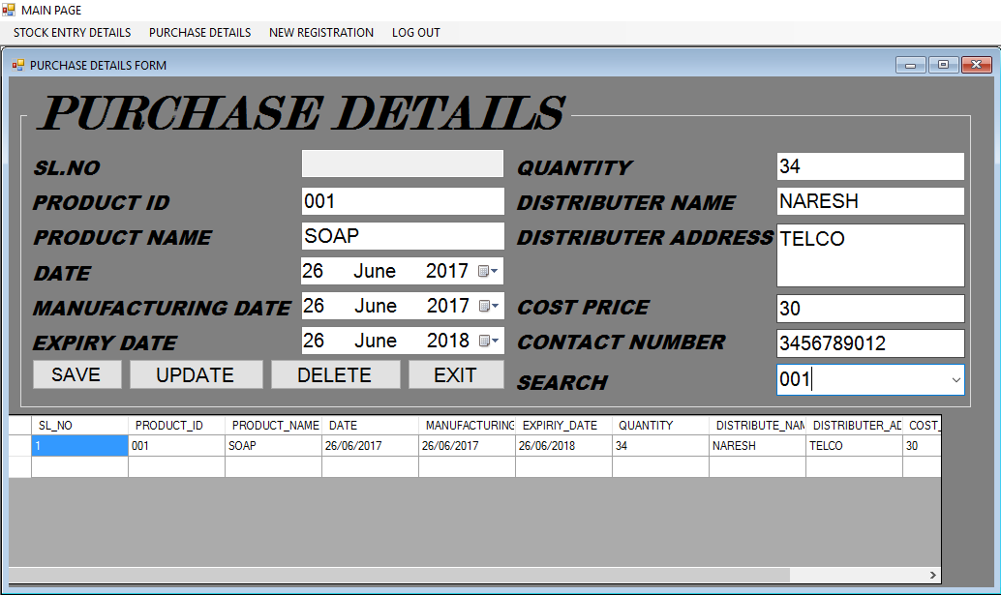
PURCHASE DETAILS FORM
16

Slide 17
This is the purchase details form which is accessed by only admin.
This page keeps the record of items present in the stock individually in an optimized manner. The details can be updated and even deleted which can only be done by the permission of admin.
17

Slide 18
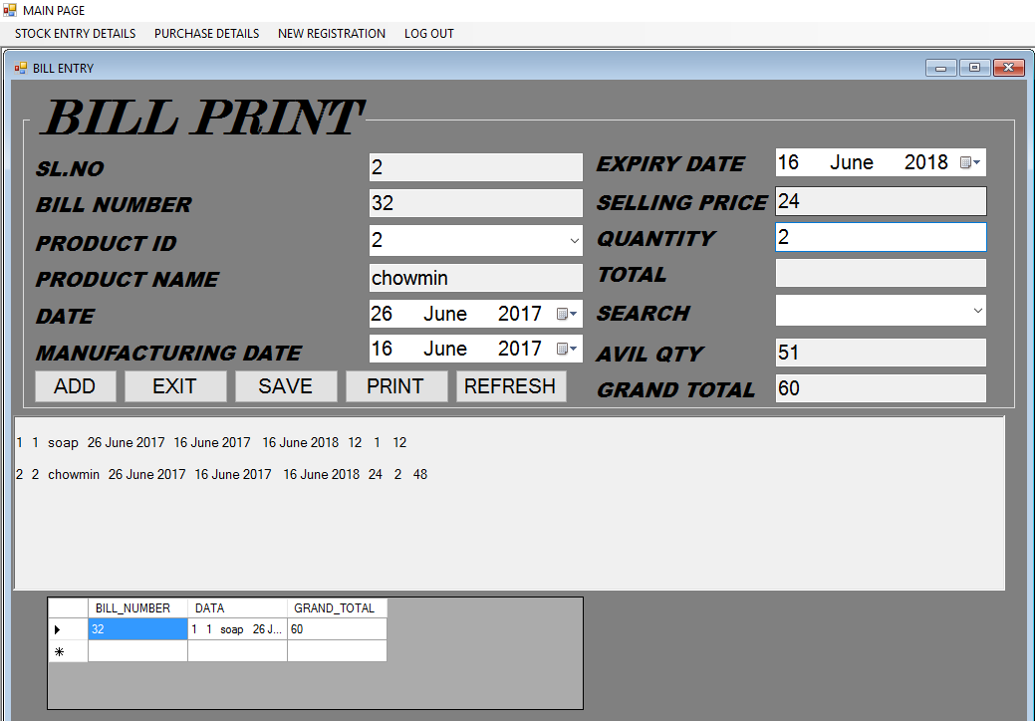
BILL PRINT FORM
18

Slide 19
This is the print bill form which can be accessed by both admin and user.
This form is used to print and save bills accordingly . In this form the data to be printed can be saved and kept for the future use.
19

Slide 20
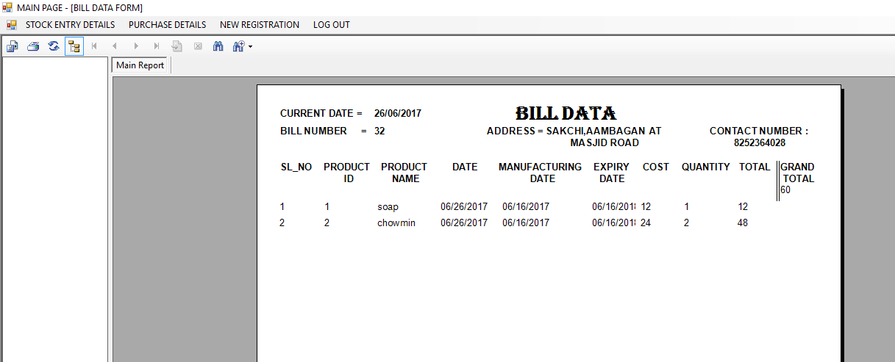
BILL DATA FORM
20

Slide 21
This is the printing form which can be accessed by both admin and user.
This form is used to print and save bills accordingly for future reference.
21

Slide 22
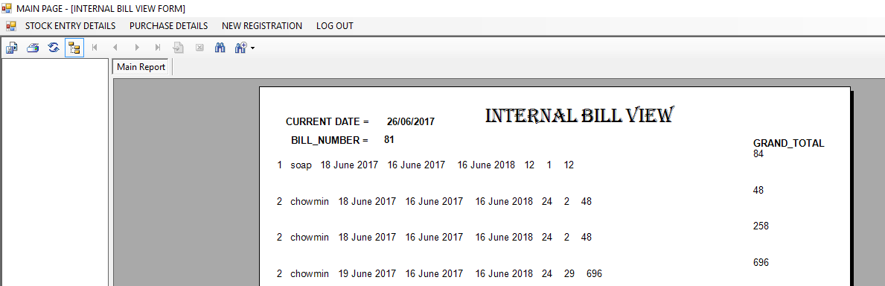
INTERNAL BILL FORM
22

Slide 23
This is the bill view printing form which can be accessed by both admin and user.
This form is used to print and save bills accordingly for future reference. It keeps the hard copies of the database along with date and current date.
23

Slide 24
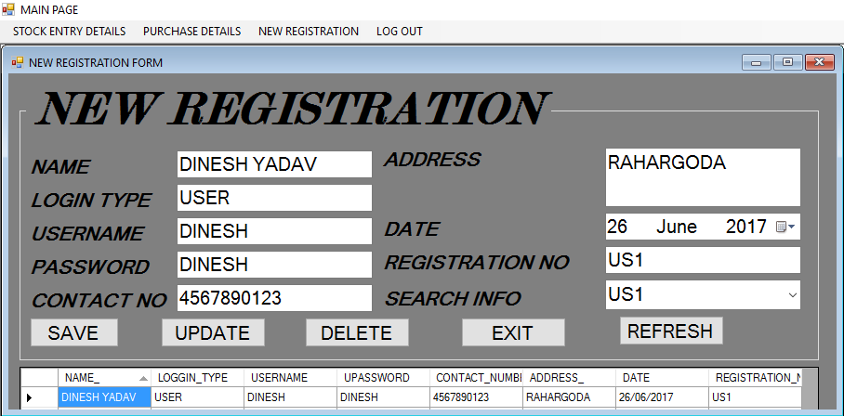
REGISTRATION FORM
24

Slide 25
This is the registry form which can be accessed by admin only.
This form is used to register new user and even can edit the saved user configurations and the admin can even delete the existing user .
25

Slide 26
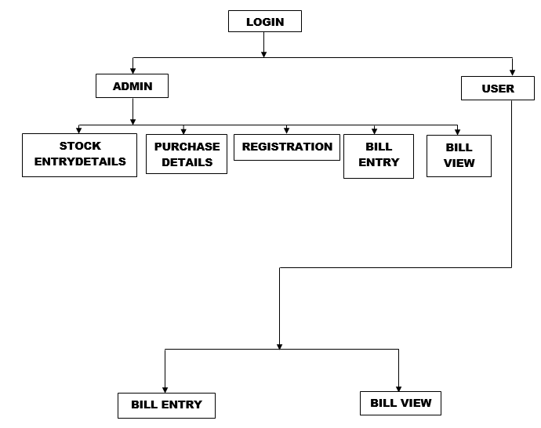
BLOCK DIAGRAM
26

Slide 27
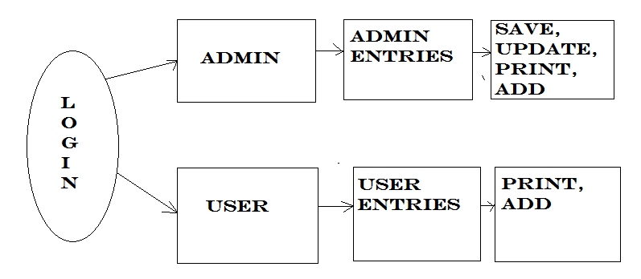
PROCESS FLOW DIAGRAM
27

Slide 28
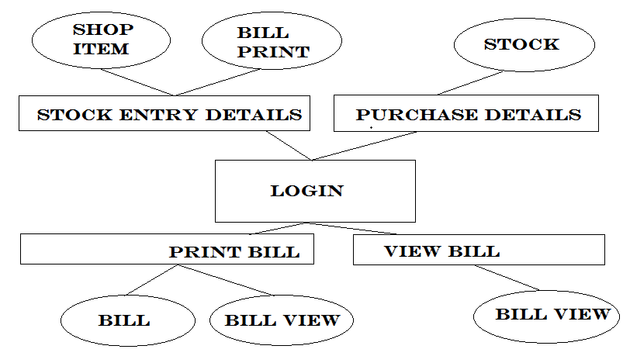
E-R DIAGRAM
28

Slide 29
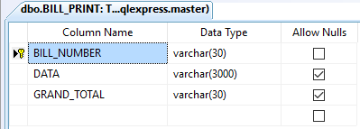
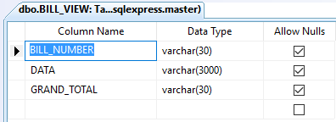
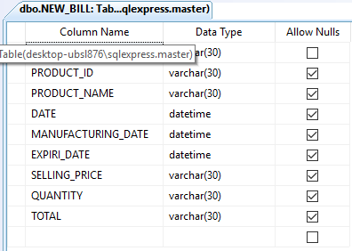
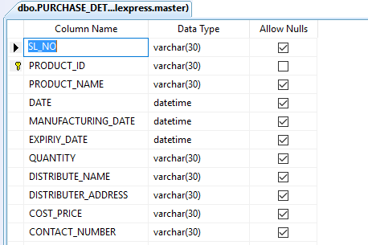
DATABASE DESIGNS
29

Slide 30
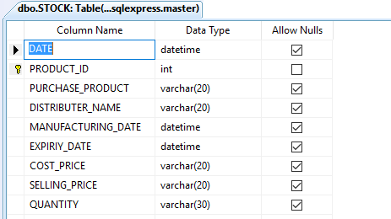
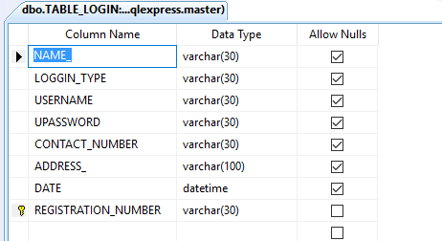
30

Slide 31

HOW IT IS SECURE
Admin privileges is provided to forms like registration form, stock entry form , purchase details form by which without admin permission no unwanted user can access it.
Due to admin privilege our data is secured by getting lost.
31

Slide 32

WHY TO IMPLEMENT ADMIN SECURITIES
As the user can delete data or may perform some theft action that is why admin privilege is required.
Duplicity of data can also be done by the respective user and data may be lost.
32

Slide 33

TESTING & VALIDATIONS
TESTING
In a software development projects, errors can be generated at any stage during the development phase. For each phase we have different techniques to eliminate the bugs that originate in that phase.
UNIT TESTING:
In these testing individuals modules of the system were tested separately for the specifications produced at the design phase. For all the modules the different test cases are produced. All the coding bugs are removed in this phase of testing.
33

Slide 34

TESTING
INTEGRATION TESTING:
In this phase of testing we considered all the different modules that we have created. A separate test plans are created and finalized. And the results are which we got is satisfactory.
SYSTEM TESTING:
In this phase of testing we have seen the entire working of the project. In this phase of testing we made validation, navigation etc.
34

Slide 35
SUMMARY
We overcame the problem of manual entry to the database.
The detailed information about the STOCK and the ITEMS PRESENT there are recorded in the database can be retrieved easily.
There will be the neat maintenance of documentation.
Easy view of reports.
Reduction in the wastage of time.
Provides more security compared to the manual system which might be followed in the present
35

Slide 36
FUTURE ENHANCEMENT
It can be used in shops and stores where there is a need to maintain lots of data at huge bulk.
It lowers the loss risks that can be generated by the user.
36

Slide 37
CONCLUSION
Accordingly, the project serves as fine resources for the SHOP requirements with high flexibility and reliability. As we stand at this juncture, with our project completed, we look back in retrospection at those six months, which has brought to this elite place.
At this time of conclusion we would like to remember all of them who helped us to complete this Grant effort successfully.
37

Slide 38
BIBLIOGRAPHY
VB.NET 2008 Complete reference
MS SQL Server 2005
38

Slide 39
THE END
39

